Slide 1

Object-oriented Programming and Quality Code
Module Overview Lecture
academy.zariba.com

Slide 2
Lecture Content
Lecturer
Previous Module Homework Notes
Lectures Overview
Evaluation, Timeline, Workshops etc.
Champions from Introduction to Programming with Games.

Slide 3
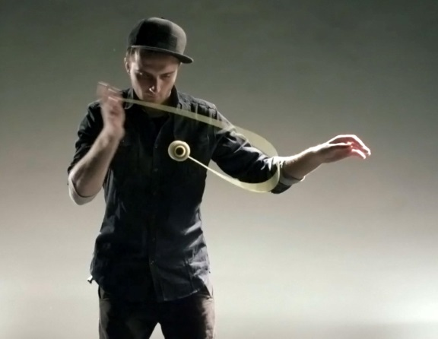

Lecturer
Martin Antonov
Co-Founder and Game Designer at Fractal Games
Founder of YoYoBulgaria and EfreetYoYoCompany
Graduated Mathematics at the University of Warwick
Studied one year at the Telerik Software Academy
I like:
Tennis, yoyos, computer games (DOTA anyone?), snowboard, billiards, table football etc.

Slide 4
Homework Notes
What is wrong with the following lines of code?
int a = 5;
int a;
int a,b,c;
a = int.Parse(Console.ReadLine());
b = 5;
...
c = 3;
4. Program.cs, class Program
5. Homework1.cs, Homework2.cs, Problem1.cs etc.
6. if(bunnyIsAlive)
DoSomething();
7. Math.Pow(x,2);
8. devide, rectangule etc.

Slide 5
Homework Notes
What is wrong with the following code? The problem is to find the maximum of 2 values.
static void Main()
{
int firstNumber = int.Parse(Console.ReadLine());
Int secondNumber = int.Parse(Console.ReadLine());
Console.WriteLine(Math.Max(firstNumber,secondNumber));
}

Slide 6
Homework Notes
What is wrong with the following code? This is an actual homework copied 1:1.
Class Program
{
static void Main()
{
int n = Convert.ToInt32(Console.ReadLine());
//int n2=n;
int i = 0;
int y = 0;
while(i<n)
{
//n2+=n2;
int n2 = Convert.ToInt32(Console.ReadLine());
y=y+n2;
i++;
}
Console.WriteLine(y);
}
}

Slide 7
Homework Notes
Additional notes:
Name your solutions appropriately (“Homework 1” is bad naming).
Name your projects inside the solution appropriately (do not just put Homework1 or Problem1,2,3 etc.).
Insert the description of the problem on top as a comment. You can also insert the author.
Should not be using recursion on QuickSort and BinarySearch.
Only 1 person made the 2048 game. Thus, it will be given as a COMPULSORY homework after one of the lectures (made with OOP).

Slide 8
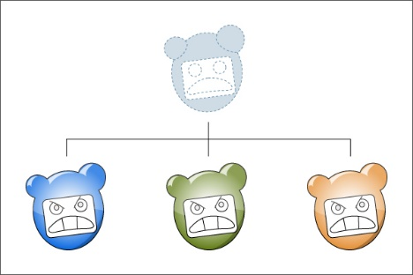
Object-oriented Programming
and Quality Code
0. Module Introduction
Exception Handling in C# (short)
Defining Classes Part 1 (easy)
Defining Classes Part 2 (harder)
Extension methods, delegates, lambda, dynamic and LINQ (best)
OOP Principles Part 1 (important)
OOP Principles Part 2 (important)
Common Type System in .Net (short)
Quality Code – Proper Naming
Quality Code – Proper OOP
Quality Code – Principles and Design Patterns
MonoGame/XNA – brief overview (short)
Monopoly Architecture and Planning (short)
Implementing Monopoly with MonoGame(2-3 lectures)

Slide 9
Workshops
EscapeFloor Game – exam solution
SpacecraftWars – exam solution
Some of the shorter lectures will also be done in the workshops
Questions from students

Slide 10

Evaluation
This Course will be evaluated as follows:
20% Homework
20% Test
60% Teamwork Project
To successfully complete the course:
You must not skip lectures
You must present your homework on time
You MUST!!! participate in teamwork projects

Slide 11
Timeline
1.5 - 2 months
2 times a week from 18:30 to 22:00
Optional Workshop on Saturday from 11:00 to 13:00
There will be 1 or 2 weeks without lectures after we have covered the whole material. Those should be used to make your team projects.

Slide 12
The Teamwork Project
For your teamwork projects you will have to create a game with the MonoGame engine.
Evaluation of the team projects will emphasize on the quality of the code, architecture and design patterns used (same or similar to Monopoly). Roughly 40%
The other 60% will be for game idea, graphics, gameplay, execution, playability, fun element etc.
START EARLY! – you can start planning and discussing game ideas as early as lecture 2 when the teams will be announced. You can make your OOP structure after lecture 6. The last 1-2 weeks should be left for the graphics implementation, design patterns and quality code.

Slide 13

How to study
Do your homework
Participate in lectures
Ask questions
Watch the videos online
Participate in teamwork
USE GOOGLE!

Slide 14
Champions from the Introduction Module
Best Homework
Best Teamwork Projects
Best Exams
Petko Dimitrov – overall
Bogomil Tomov - 2048
1st PacMan – 34
2nd Space Game – 33
3rd The adventures of @ - 32
Group 1 – Ferah Sherifov 120% Max Score
Group 2 – Stefan Nedyalkov, Dimitrina Georgieva

Slide 15

References

Slide 16



Zariba Academy
Questions

